Slide 1


3: Data Wrangling with Pandas

Slide 2
Data Wrangling with Pandas
In this lesson, we will cover the following topics:
Understanding data wrangling
Cleaning data
Reshaping data
Handling duplicate, missing, or invalid data
Notes:
In the previous lesson, we learned about the main pandas data structures, how to create DataFrame objects with our collected data, and various ways to inspect, summarize, filter, select, and work with DataFrame objects. Now that we are well versed in the initial data collection and inspection stage, we can begin our foray into the world of data wrangling.
As mentioned in Introduction to Data Analysis, preparing data for analysis is often the largest portion of the job time-wise for those working with data, and often the least enjoyable. On the bright side, pandas is well equipped to help with these tasks, and, by mastering the skills presented in this course, we will be able to get to the more interesting parts sooner.
It should be noted that data wrangling isn't something we do merely once in our analysis; it is highly likely that we will do some data wrangling and move on to another analysis task, such as data visualization, only to find that we need to do additional data wrangling. The more familiar we are with the data, the better we will be able to prepare the data for our analysis. It's crucial to form an intuition of what types our data should be, what format we need our data to be in for the visualization that would best convey what we are looking to show, and the data points we should collect for our analysis. This comes with experience, so we must practice the skills that will be covered in this lesson on our own data every chance we get.
Since this is a very large topic, our coverage of data wrangling will be split between this lesson and Aggregating Pandas DataFrames. In this lesson, we will get an overview of data wrangling before exploring the National Centers for Environmental Information (NCEI) API for climate data and walking through the process of collecting temperature data from it using the requests library. Then, we will discuss data wrangling tasks that deal with preparing data for some initial analyses and visualizations (which we will learn about in Visualizing Data with Pandas and Matplotlib, and Plotting with Seaborn and Customization Techniques). We will address some more advanced aspects of data wrangling that relate to aggregations and combining datasets in Aggregating Pandas DataFrames.

Slide 3
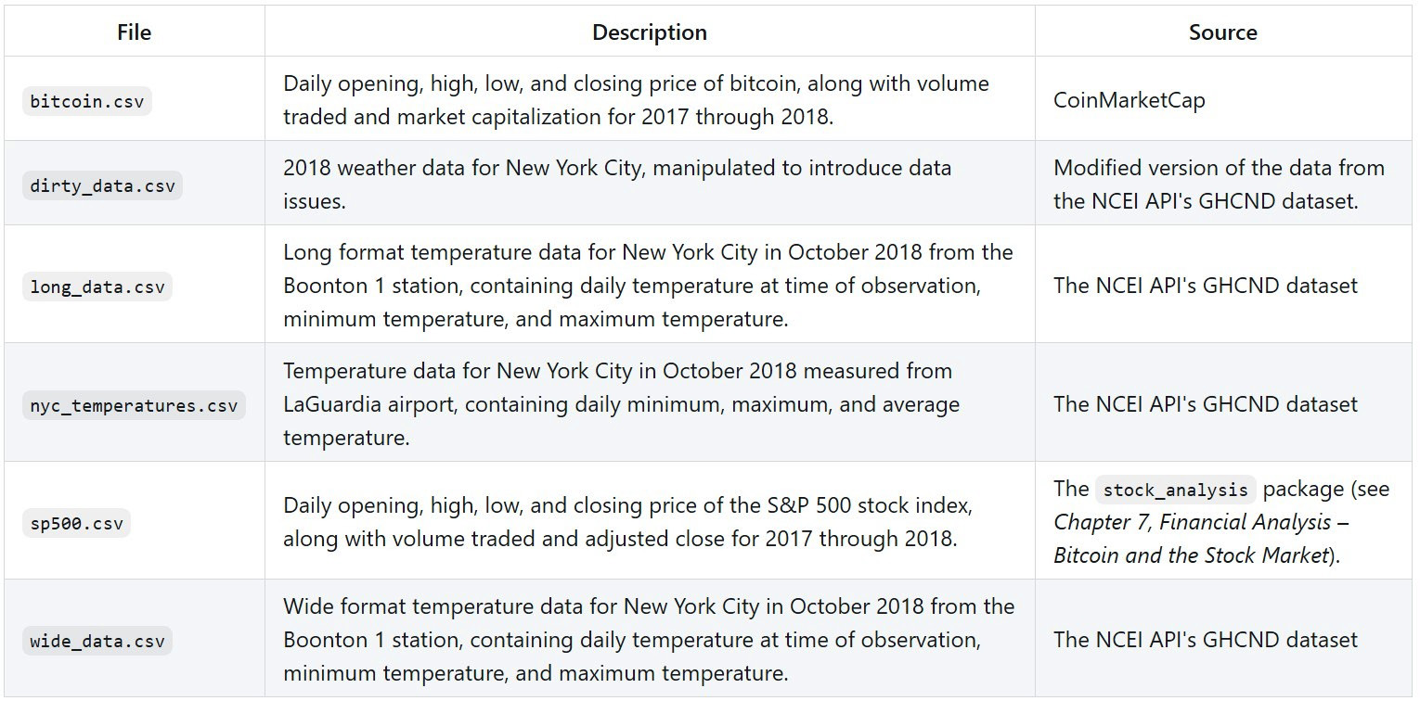
lesson materials
The following files are in the data/ directory:
Notes:
The materials for this lesson can be found on GitHub at https://github.com/fenago/data-analysis-pandas There are five notebooks that we will work through, each numbered according to when they will be used, and two directories, data/ and exercises/, which contain all the CSV files necessary for the aforementioned notebooks and end-of-lesson exercises, respectively.
We will begin in the 1-wide_vs_long.ipynb notebook by discussing wide versus long format data. Then, we will collect daily temperature data from the NCEI API, which can be found at https://www.ncdc.noaa.gov/cdo-web/webservices/v2, in the 2-using_the_weather_api.ipynb notebook. The documentation for the Global Historical Climatology Network – Daily (GHCND) dataset we will be using can be found at https://www1.ncdc.noaa.gov/pub/data/cdo/documentation/GHCND_documentation.pdf.
Important note
The NCEI is part of the National Oceanic and Atmospheric Administration (NOAA). As indicated by the URL for the API, this resource was created when the NCEI was called the NCDC. Should the URL for this resource change in the future, search for NCEI weather API to find the updated one.
In the 3-cleaning_data.ipynb notebook, we will learn how to perform an initial round of cleaning on the temperature data and some financial data, which was collected using the stock_analysis package that we will build in lesson 7, Financial Analysis – Bitcoin and the Stock Market. Afterward, we will walk through ways to reshape our data in the 4-reshaping_data.ipynb notebook. Finally, in the 5-handling_data_issues.ipynb notebook, we will learn about some strategies for dealing with duplicate, missing, or invalid data using some dirty data that can be found in data/dirty_data.csv. The text will indicate when it's time to switch between notebooks.

Slide 4
Understanding data wrangling
When we perform data wrangling, we are taking our input data from its original state and putting it in a format where we can perform meaningful analysis on it.
Data manipulation is another way to refer to this process.
There is no set list of operations; the only goal is that the data post-wrangling is more useful to us than when we started.
Notes:
Like any professional field, data analysis is filled with buzzwords, and it can often be difficult for newcomers to understand the lingo—the topic of this lesson is no exception.
In practice, there are three common tasks involved in the data wrangling process:
Data cleaning
Data transformation
Data enrichment
It should be noted that there is no inherent order to these tasks, and it is highly probable that we will perform each many times throughout the data wrangling process. This idea brings up an interesting conundrum: if we need to wrangle our data to prepare it for our analysis, isn't it possible to wrangle it in such a way that we tell the data what to say instead of us learning what it is saying?
"If you torture the data long enough, it will confess to anything."
— Ronald Coase, winner of a Nobel Prize in Economics
Those working with data will find it is very easy to distort the truth by manipulating the data. However, it is our duty to do our best to avoid deceit by keeping the effect our actions have on the data's integrity in mind, and by explaining the process we took to draw our conclusions to the people who consume our analyses, so that they too may make their own judgments.

Slide 5
Data cleaning
Some essential data cleaning tasks to master include the following:
Renaming
Sorting and reordering
Data type conversions
Handling duplicate data
Addressing missing or invalid data
Filtering to the desired subset of data
Notes:
Once we have collected our data, brought it into a DataFrame object, and used the skills we discussed in lesson 2, Working with Pandas DataFrames, to familiarize ourselves with the data, we will need to perform some data cleaning. An initial round of data cleaning will often give us the bare minimum we need to start exploring our data.
Data cleaning is the best starting point for data wrangling, since having the data stored as the correct data types and easy-to-reference names will open up many avenues for exploration, such as summary statistics, sorting, and filtering. Since we covered filtering in lesson 2, Working with Pandas DataFrames, we will focus on the other topics from the preceding list in this lesson.

Slide 6
Cleaning data
For this section, we will be using the nyc_temperatures.csv file, which contains the maximum daily temperature (TMAX), minimum daily temperature (TMIN), and the average daily temperature (TAVG) from the LaGuardia Airport station in New York City for October 2018:
>>> import pandas as pd
>>> df = pd.read_csv('data/nyc_temperatures.csv')
>>> df.head()
Notes:
Let's move on to the 3-cleaning_data.ipynb notebook for our discussion of data cleaning. As usual, we will begin by importing pandas and reading in our data.

Slide 7
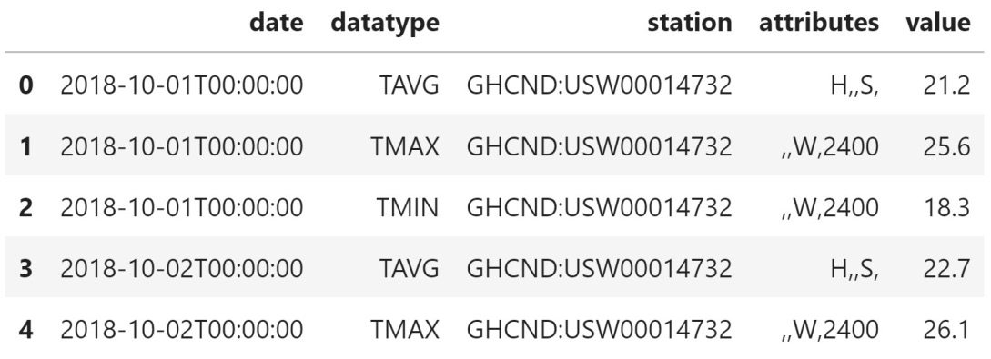
Cleaning data
We retrieved long format data from the API; for our analysis, we want wide format data, but we will address that in the Pivoting DataFrames section, later in this lesson:
Notes:
For now, we will focus on making little tweaks to the data that will make it easier for us to use: renaming columns, converting each column into the most appropriate data type, sorting, and reindexing. Often, this will be the time to filter the data down, but we did that when we worked on requesting data from the API; for a review of filtering with pandas, refer to lesson 2, Working with Pandas DataFrames.

Slide 8
Renaming columns
Since the API endpoint we used could return data of any units and category, it had to call that column value.
We only pulled temperature data in Celsius, so all our observations have the same units.
This means that we can rename the value column so that it's clear what data we are working with:
>>> df.columns
Index(['date', 'datatype', 'station', 'attributes', 'value'],
dtype='object')

Slide 9
Renaming columns
The DataFrame class has a rename() method that takes a dictionary mapping the old column name to the new column name.
In addition to renaming the value column, let's rename the attributes column to flags since the API documentation mentions that that column contains flags for information about data collection:
>>> df.rename(
... columns={'value': 'temp_C', 'attributes': 'flags'},
... inplace=True
... )

Slide 10
Renaming columns
Most of the time, pandas will return a new DataFrame object; however, since we passed in inplace=True, our original dataframe was updated instead.
Always be careful with in-place operations, as they might be difficult or impossible to undo.
Our columns now have their new names:
>>> df.columns
Index(['date', 'datatype', 'station', 'flags', 'temp_C'],
dtype='object')
Notes:
Tip
Both Series and Index objects can also be renamed using their rename() methods. Simply pass in the new name. For example, if we have a Series object called temperature and we want to rename it temp_C, we can run temperature.rename('temp_C'). The variable will still be called temperature, but the name of the data in the series itself will now be temp_C.

Slide 11
Renaming columns
We can also do transformations on the column names with rename().
For instance, we can put all the column names in uppercase:
>>> df.rename(str.upper, axis='columns').columns
Index(['DATE', 'DATATYPE', 'STATION', 'FLAGS', 'TEMP_C'],
dtype='object')
Notes:
This method even lets us rename the values of the index, although this is something we don't have use for now since our index is just numbers. However, for reference, we would simply change axis='columns' in the preceding code to axis='rows'.

Slide 12
Type conversion
Note that, sometimes, we may have data that we believe should be a certain type, such as a date, but it is stored as a string; this could be for a very valid reason—data could be missing.
In the case of missing data encoded as text (for example, ? or N/A), pandas will store it as a string when reading it in to allow for this data.
It will be marked as object when we use the dtypes attribute on our dataframe.
Notes:
Now that the column names are indicative of the data they contain, we can check what types of data they hold. We should have formed an intuition as to what the data types should be after looking at the first few rows when we inspected the dataframe with the head() method previously. With type conversion, we aim to reconcile what the current data types are with what we believe they should be; we will be changing how our data is represented.
If we try to convert (or cast) these columns, we will either get an error or our result won't be what we expected. For example, if we have strings of decimal numbers, but try to convert the column into integers, we will get an error since Python knows they aren't integers; however, if we try to convert decimal numbers into integers, we will lose any information after the decimal point.

Slide 13
Type conversion
That being said, let's examine the data types in our temperature data.
Note that the date column isn't actually being stored as a datetime:
>>> df.dtypes
date object
datatype object
station object
flags object
temp_C float64
dtype: object

Slide 14
Type conversion
We can use the pd.to_datetime() function to convert it into a datetime:
>>> df.loc[:,'date'] = pd.to_datetime(df.date)
>>> df.dtypes
date datetime64[ns]
datatype object
station object
flags object
temp_C float64
dtype: object

Slide 15
Type conversion
This is much better.
Now, we can get useful information when we summarize the date column:
>>> df.date.describe(datetime_is_numeric=True)
count 93
mean 2018-10-16 00:00:00
min 2018-10-01 00:00:00
25% 2018-10-08 00:00:00
50% 2018-10-16 00:00:00
75% 2018-10-24 00:00:00
max 2018-10-31 00:00:00
Name: date, dtype: object
Notes:
Dealing with dates can be tricky since they come in many different formats and time zones; fortunately, pandas has more methods we can use for dealing with converting datetime objects.

Slide 16
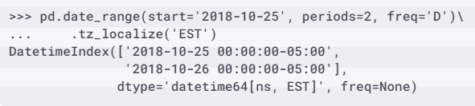
Type conversion
For example, when working with a DatetimeIndex object, if we need to keep track of time zones, we can use the tz_localize() method to associate our datetimes with a time zone:

Slide 17
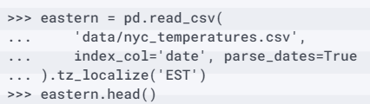
Type conversion
This also works with Series and DataFrame objects that have an index of type DatetimeIndex.
We can read in the CSV file again and, this time, specify that the date column will be our index and that we should parse any dates in the CSV file into datetimes:

Slide 18
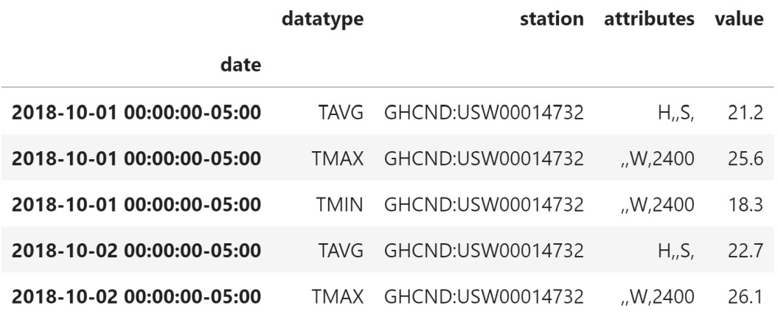
Type conversion
Note that we have added the Eastern Standard Time offset (-05:00 from UTC) to the datetimes in the index:
Notes:
We had to read the file in again for this example because we haven't learned how to change the index of our data yet (covered in the Reordering, reindexing, and sorting data section, later this lesson).

Slide 19
Type conversion
We can use the tz_convert() method to change the time zone into a different one.
Let's change our data into UTC:
>>> eastern.tz_convert('UTC').head()

Slide 20
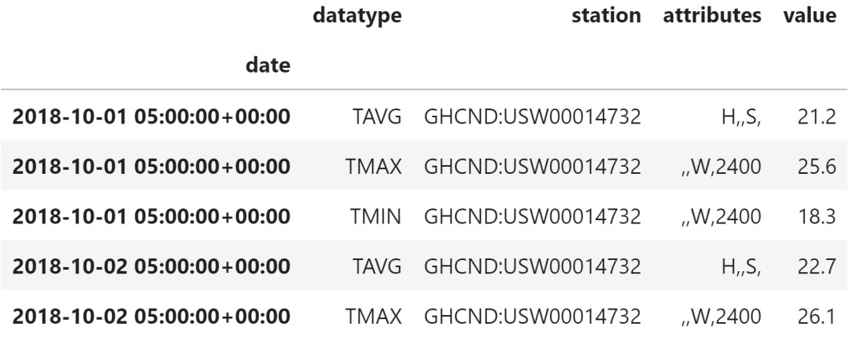
Type conversion
Now, the offset is UTC (+00:00), but note that the time portion of the date is now 5 AM; this conversion took into account the -05:00 offset:
Notes:
We can also truncate datetimes with the to_period() method, which comes in handy if we don't care about the full date. For example, if we wanted to aggregate our data by month, we could truncate our index to just the month and year and then perform the aggregation. Since we will cover aggregation in lesson 4, Aggregating Pandas DataFrames, we will just do the truncation here. Note that we first remove the time zone information to avoid a warning from pandas that the PeriodArray class doesn't have time zone information, and therefore it will be lost.

Slide 21
Type conversion
This is because the underlying data for a PeriodIndex object is stored as a PeriodArray object:
>>> eastern.tz_localize(None).to_period('M').index
PeriodIndex(['2018-10', '2018-10', ..., '2018-10', '2018-10'],
dtype='period[M]', name='date', freq='M')

Slide 22
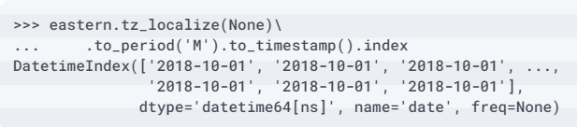
Type conversion
We can use the to_timestamp() method to convert our PeriodIndex object into a DatetimeIndex object; however, the datetimes all start at the first of the month now:
Notes:
Alternatively, we can use the assign() method to handle any type conversions by passing the column names as named parameters and their new values as the value for that argument to the method call. In practice, this will be more beneficial since we can perform many tasks in one call and use the columns we create in that call to calculate additional columns. For example, let's cast the date column to a datetime and add a new column for the temperature in Fahrenheit (temp_F). The assign() method returns a new DataFrame object, so we must remember to assign it to a variable if we want to keep it.

Slide 23
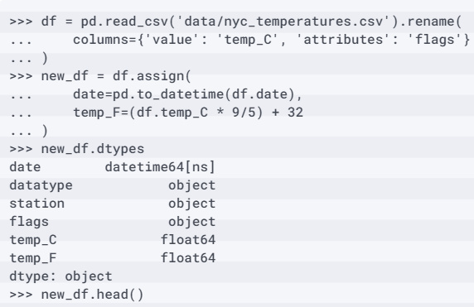
Type conversion
Here, we will create a new one.
Note that our original conversion of the dates modified the column, so, in order to illustrate that we can use assign(), we need to read our data in once more:

Slide 24
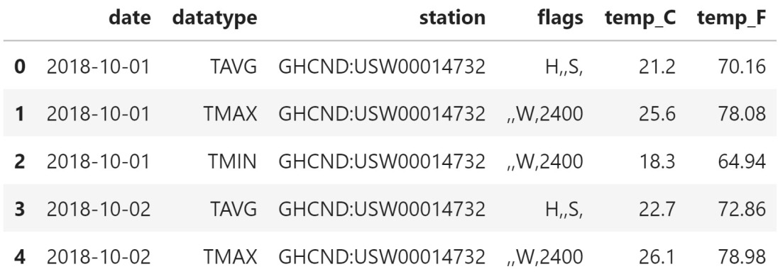
Type conversion
We now have datetimes in the date column and a new column, temp_F:
Notes:
Additionally, we can use the astype() method to convert one column at a time. As an example, let's say we only cared about the temperatures at every whole number, but we don't want to round. In this case, we simply want to chop off the information after the decimal. To accomplish this, we can cast the floats as integers. This time, we will use lambda functions (first introduced in lesson 2, Working with Pandas DataFrames), which make it possible to access the temp_F column to create the temp_F_whole column, even though df doesn't have this column before we call assign().

Slide 25
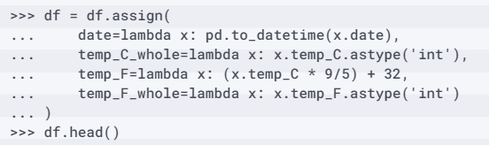
Type conversion
It is very common (and useful) to use lambda functions with assign():
Notes:
Note that we can refer to columns we've just created if we use a lambda function. It's also important to mention that we don't have to know whether to convert the column into a float or an integer: we can use pd.to_numeric(), which will convert the data into floats if it sees decimals.

Slide 26
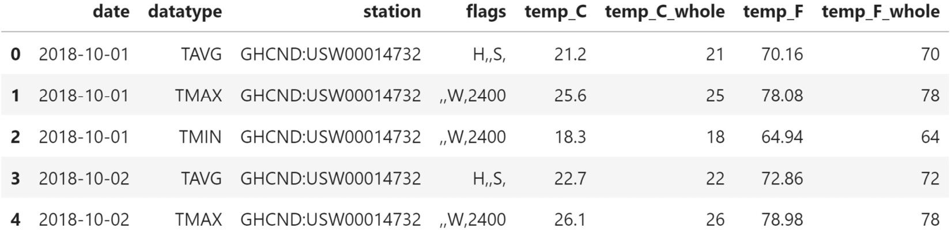
Type conversion
If all the numbers are whole, they will be converted into integers (obviously, we will still get errors if the data isn't numeric at all):
Notes:
Lastly, we have two columns with data currently being stored as strings that can be represented in a better way for this dataset. The station and datatype columns only have one and three distinct values, respectively, meaning that we aren't being efficient with our memory use since we are storing them as strings. We could potentially have issues with analyses further down the line. Pandas has the ability to define columns as categorical; certain statistical operations both within pandas and other packages will be able to handle this data, provide meaningful statistics on them, and use them properly. Categorical variables can take on one of a few values; for example, blood type would be a categorical variable—people can only have one of A, B, AB, or O.
Going back to the temperature data, we only have one value for the station column and only three distinct values for the datatype column (TAVG, TMAX, TMIN).

Slide 27
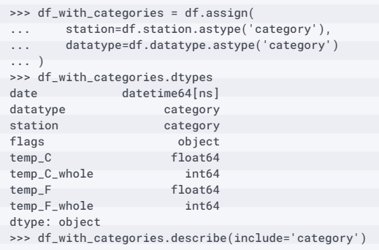
Type conversion
We can use the astype() method to cast these into categories and look at the summary statistics:

Slide 28
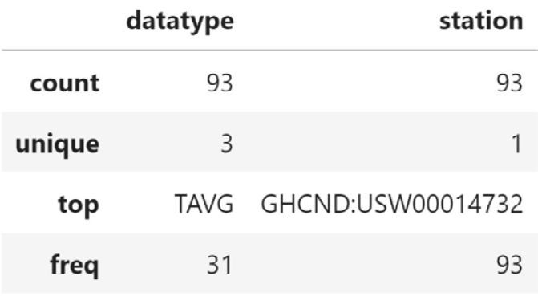
Type conversion
The summary statistics for categories are just like those for strings.
We can see the number of non-null entries (count), the number of unique values (unique), the mode (top), and the number of occurrences of the mode (freq):

Slide 29
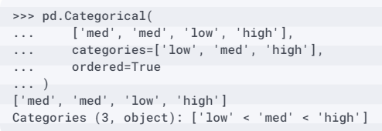
Type conversion
The categories we just made don't have any order to them, but pandas does support this:
Notes:
When the columns in our dataframe are stored in the appropriate type, it opens up additional avenues for exploration, such as calculating statistics, aggregating the data, and sorting the values. For example, depending on our data source, it's possible that the numeric data is represented as a string, in which case attempting to sort on the values will reorder the contents lexically, meaning the result could be 1, 10, 11, 2, rather than 1, 2, 10, 11 (numerical sort). Similarly, if we have dates represented as strings in a format other than YYYY-MM-DD, sorting on this information may result in non-chronological order; however, by converting the date strings with pd.to_datetime(), we can chronologically sort dates that are provided in any format. Type conversion makes it possible to reorder both the numeric data and the dates according to their values, rather than their initial string representations.

Slide 30
Reordering, reindexing, and sorting data
We will often find the need to sort our data by the values of one or many columns.
Say we wanted to find the days that reached the highest temperatures in New York City during October 2018; we could sort our values by the temp_C (or temp_F) column in descending order and use head() to select the number of days we wanted to see.
To accomplish this, we can use the sort_values() method.
Let's look at the top 10 days:
>>> df[df.datatype == 'TMAX']\
... .sort_values(by='temp_C', ascending=False).head(10)

Slide 31
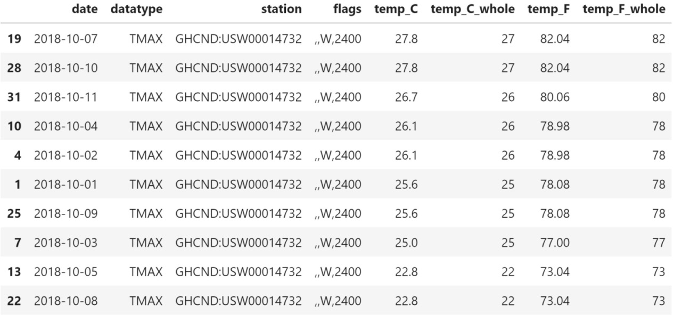
Reordering, reindexing, and sorting data
Notes:
This shows us that on October 7th and October 10th the temperature reached its highest value during the month of October 2018, according to the LaGuardia station. We also have ties between October 2nd and 4th, October 1st and 9th, and October 5th and 8th, but notice that the dates aren't always sorted—the 10th is after the 7th, but the 4th comes before the 2nd:

Slide 32
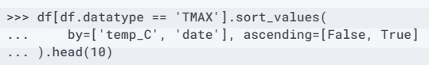
Reordering, reindexing, and sorting data
The sort_values() method can be used with a list of column names to break ties.
The order in which the columns are provided will determine the sort order, with each subsequent column being used to break ties.
As an example, let's make sure the dates are sorted in ascending order when breaking ties:

Slide 33

Reordering, reindexing, and sorting data
Notice how October 2nd is now above October 4th, despite both having the same temperature reading:
Notes:
Since we are sorting in ascending order, in the case of a tie, the date that comes earlier in the year will be above the later one.
Tip
In pandas, the index is tied to the rows—when we drop rows, filter, or do anything that returns only some of the rows, our index may look out of order (as we saw in the previous examples). At the moment, the index just represents the row number in our data, so we may be interested in changing the values so that we have the first entry at index 0. To have pandas do so automatically, we can pass ignore_index=True to sort_values().
Pandas also provides an additional way to look at a subset of the sorted values; we can use nlargest() to grab the n rows with the largest values according to specific criteria and nsmallest() to grab the n smallest rows, without the need to sort the data beforehand. Both accept a list of column names or a string for a single column.

Slide 34
Reordering, reindexing, and sorting data
Let's grab the top 10 days by average temperature this time:
>>> df[df.datatype == 'TAVG'].nlargest(n=10, columns='temp_C')

Slide 35
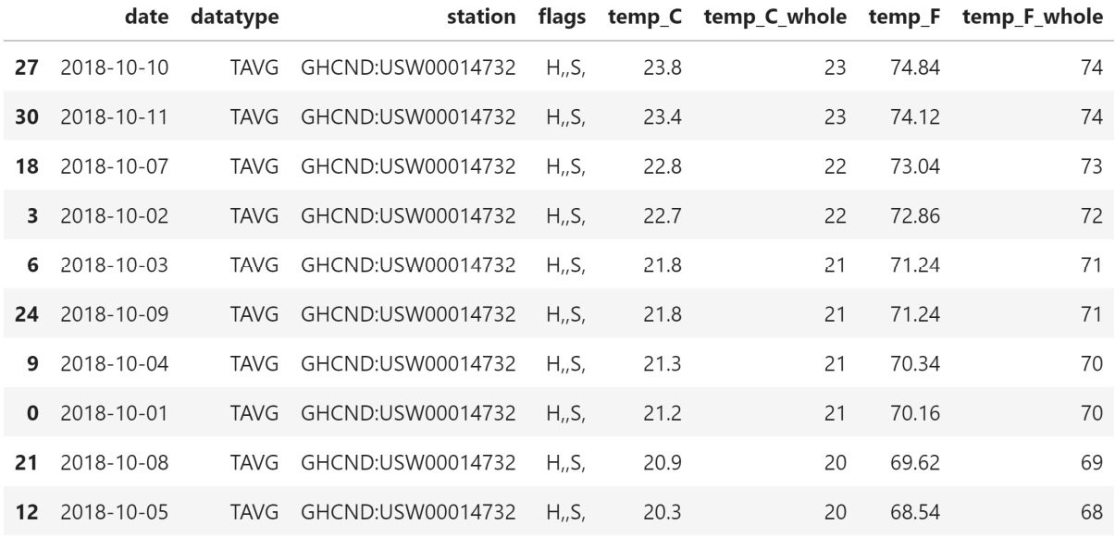
Reordering, reindexing, and sorting data
We get the warmest days (on average) in October:
Notes:
We aren't limited to sorting values; if we wish, we can even order the columns alphabetically and sort the rows by their index values. For these tasks, we can use the sort_index() method. By default, sort_index() will target the rows so that we can do things such as order the index after performing an operation that shuffles it.

Slide 36
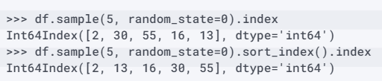
Reordering, reindexing, and sorting data
For instance, the sample() method will give us randomly selected rows, which will lead to a jumbled index, so we can use sort_index() to order them afterward:
Notes:
Tip
If we need the result of sample() to be reproducible, we can pass in a seed, set to a number of our choosing (using the random_state argument). The seed initializes a pseudorandom number generator, so, provided that the same seed is used, the results will be the same.
When we want to target columns, we must pass in axis=1; rows will be the default (axis=0). Note that this argument is present in many pandas methods and functions (including sample()), so it's important to understand what it means.

Slide 37
Reordering, reindexing, and sorting data
Let's use this knowledge to sort the columns of our dataframe alphabetically:
>>> df.sort_index(axis=1).head()

Slide 38
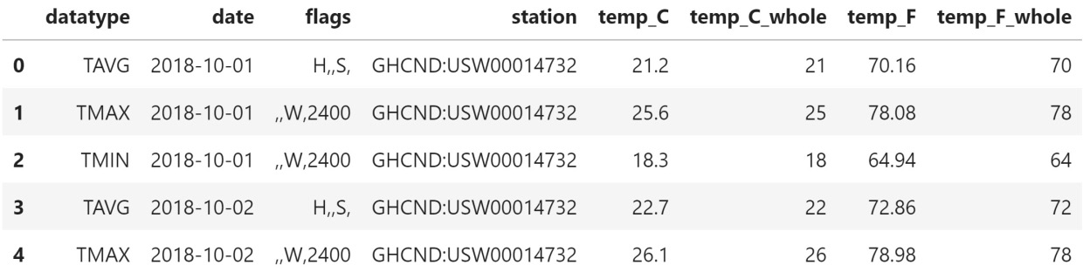
Reordering, reindexing, and sorting data
Having our columns in alphabetical order can come in handy when using loc[] because we can specify a range of columns with similar names; for example, we could now use df.loc[:,'station':'temp_F_whole'] to easily grab all of our temperature columns, along with the station information:
Notes:
Important note
Both sort_index() and sort_values() return new DataFrame objects. We must pass in inplace=True to update the dataframe we are working with.
The sort_index() method can also help us get an accurate answer when we're testing two dataframes for equality. Pandas will check that, in addition to having the same data, both have the same values for the index when it compares the rows. If we sort our dataframe by temperature in Celsius and check whether it is equal to the original dataframe, pandas tells us that it isn't.

Slide 39
Reordering, reindexing, and sorting data
We must sort the index to see that they are the same:
>>> df.equals(df.sort_values(by='temp_C'))
False
>>> df.equals(df.sort_values(by='temp_C').sort_index())
True

Slide 40
Reordering, reindexing, and sorting data
Sometimes, we don't care too much about the numeric index, but we would like to use one (or more) of the other columns as the index instead.
In this case, we can use the set_index() method.
Let's set the date column as our index:
>>> df.set_index('date', inplace=True)
>>> df.head()

Slide 41
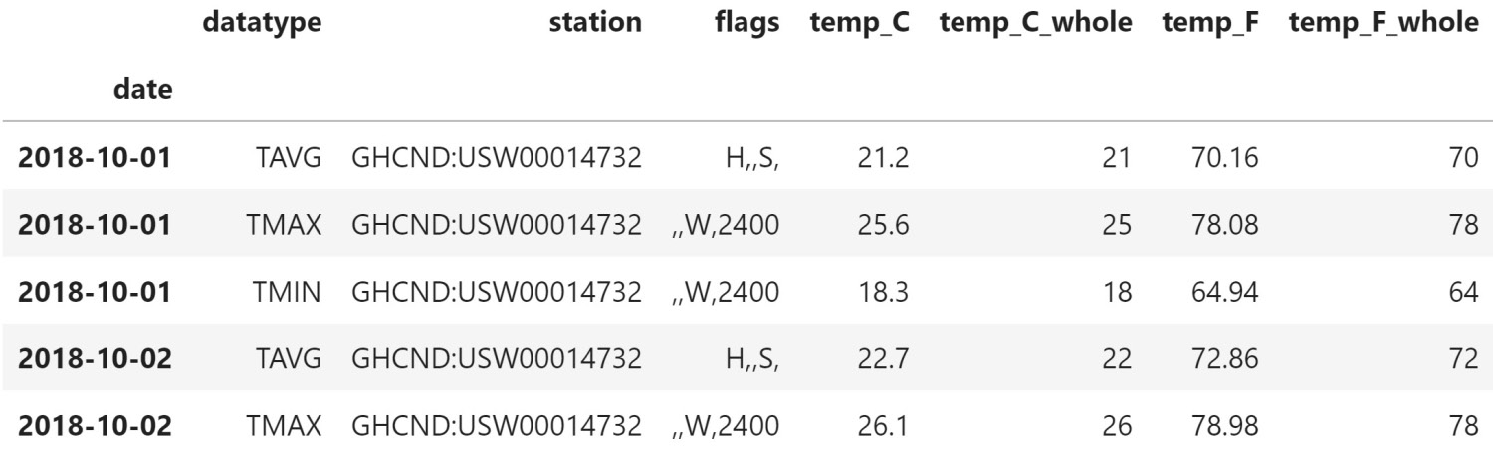
Reordering, reindexing, and sorting data
Notice that the date column has moved to the far left where the index goes, and we no longer have the numeric index:
Notes:
Tip
We can also provide a list of columns to use as the index. This will create a MultiIndex object, where the first element in the list is the outermost level and the last is the innermost. We will discuss this further in the Pivoting DataFrames section.
Setting the index to a datetime lets us take advantage of datetime slicing and indexing, which we briefly discussed in lesson 2, Working with Pandas DataFrames. As long as we provide a date format that pandas understands, we can grab the data. To select all of 2018, we can use df.loc['2018']; for the fourth quarter of 2018, we can use df.loc['2018-Q4']; and for October, we can use df.loc['2018-10'].

Slide 42
Reordering, reindexing, and sorting data
These can also be combined to build ranges.
Note that loc[] is optional when using ranges:
>>> df['2018-10-11':'2018-10-12']

Slide 43
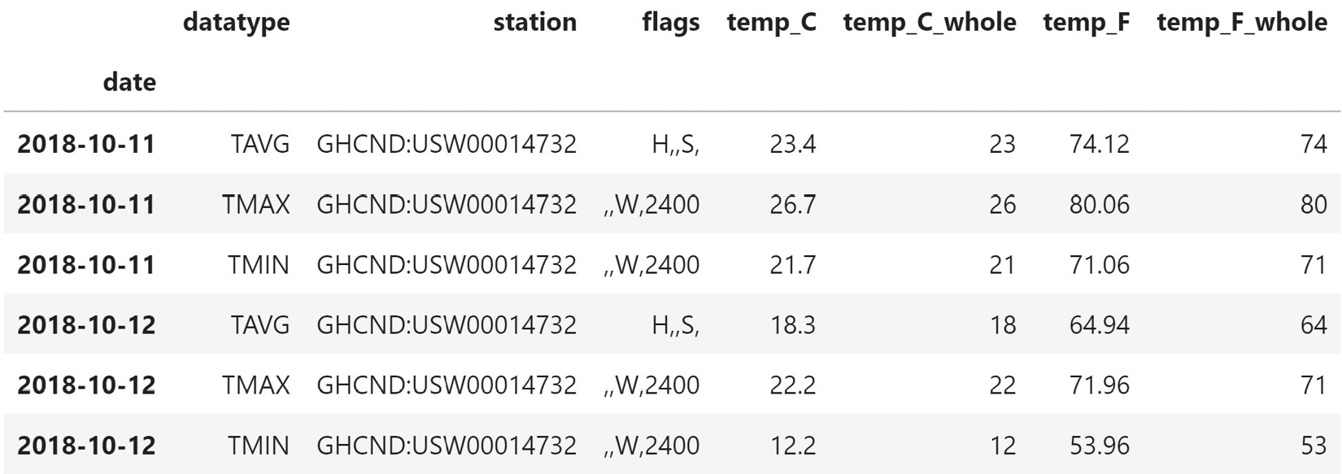
Reordering, reindexing, and sorting data
This gives us the data from October 11, 2018 through October 12, 2018 (inclusive of both endpoints):

Slide 44
Reordering, reindexing, and sorting data
We can use the reset_index() method to restore the date column:
>>> df['2018-10-11':'2018-10-12'].reset_index()

Slide 45
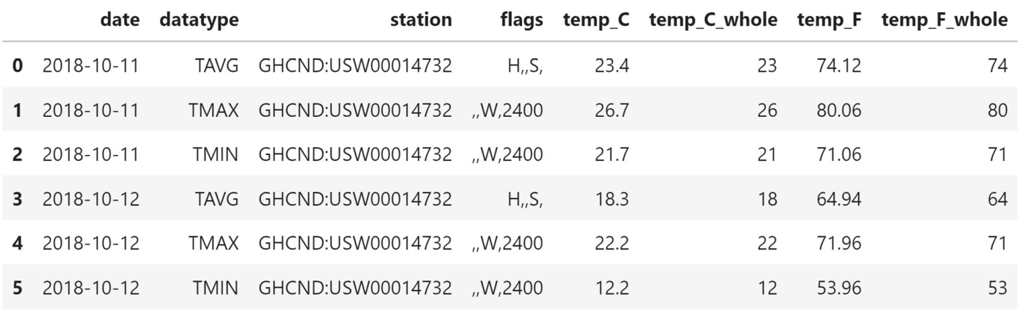
Reordering, reindexing, and sorting data
Our index now starts at 0, and the dates are now in a column called date.
This is especially useful if we have data that we don't want to lose in the index, such as the date, but need to perform an operation as if it weren't in the index:
Notes:
In some cases, we may have an index we want to continue to use, but we need to align it to certain values. For this purpose, we have the reindex() method. We provide it with an index to align our data to, and it adjusts the index accordingly. Note that this new index isn't necessarily part of the data—we simply have an index and want to match the current data up to it.
As an example, we will turn to the S&P 500 stock data in the sp500.csv file. It contains the opening, high, low, and closing (also called OHLC) prices daily for the S&P 500 from 2017 through the end of 2018, along with volume traded and the adjusted close (which we won't use).

Slide 46
Reordering, reindexing, and sorting data
Let's read it in, setting the date column as the index and parsing the dates:
>>> sp = pd.read_csv(
... 'data/sp500.csv', index_col='date', parse_dates=True
... ).drop(columns=['adj_close']) # not using this column
Notes:
Let's see what our data looks like and mark the day of the week for each row in order to understand what the index contains. We can easily isolate the date part from an index of type DatetimeIndex. When isolating date parts, pandas will give us the numeric representation of what we are looking for; if we are looking for the string version, we should look to see whether there is already a method before writing our own conversion function.

Slide 47
Reordering, reindexing, and sorting data
In this case, it's day_name():
>>> sp.head(10)\
... .assign(day_of_week=lambda x: x.index.day_name())
Notes:
Tip
We can also do this with a series, but first, we need to access the dt attribute. For example, if we had a date column in the sp dataframe, we could grab the month with sp.date.dt.month. You can find the full list of what can be accessed at https://pandas.pydata.org/pandas-docs/stable/reference/series.html#datetimelike-properties.

Slide 48
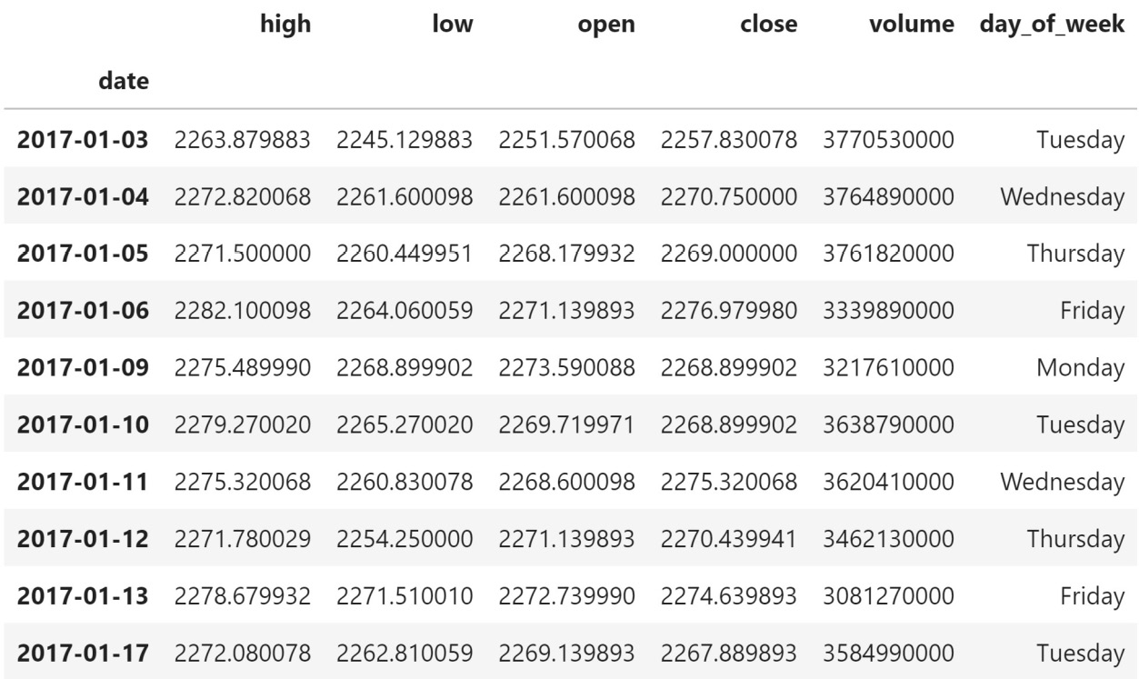
Reordering, reindexing, and sorting data
Since the stock market is closed on the weekend (and holidays), we only have data for weekdays:
Notes:
If we were analyzing the performance of a group of assets in a portfolio that included the S&P 500 and something that trades on the weekend, such as bitcoin, we would need to have values for every day of the year for the S&P 500. Otherwise, when looking at the daily value of our portfolio we would see huge drops every day the market was closed. To illustrate this, let's read in the bitcoin data from the bitcoin.csv file and combine the S&P 500 and bitcoin data into a portfolio.

Slide 49
Reordering, reindexing, and sorting data
The bitcoin data also contains OHLC data and volume traded, but it comes with a column called market_cap that we don't need, so we have to drop that first:
>>> bitcoin = pd.read_csv(
... 'data/bitcoin.csv', index_col='date', parse_dates=True
... ).drop(columns=['market_cap'])
Notes:
To analyze the portfolio, we will need to aggregate the data by day; this is a topic for lesson 4, Aggregating Pandas DataFrames, so, for now, don't worry too much about how this aggregation is being performed—just know that we are summing up the data by day.

Slide 50
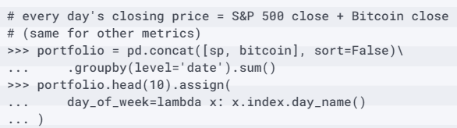
Reordering, reindexing, and sorting data
For example, each day's closing price will be the sum of the closing price of the S&P 500 and the closing price of bitcoin:

Slide 51
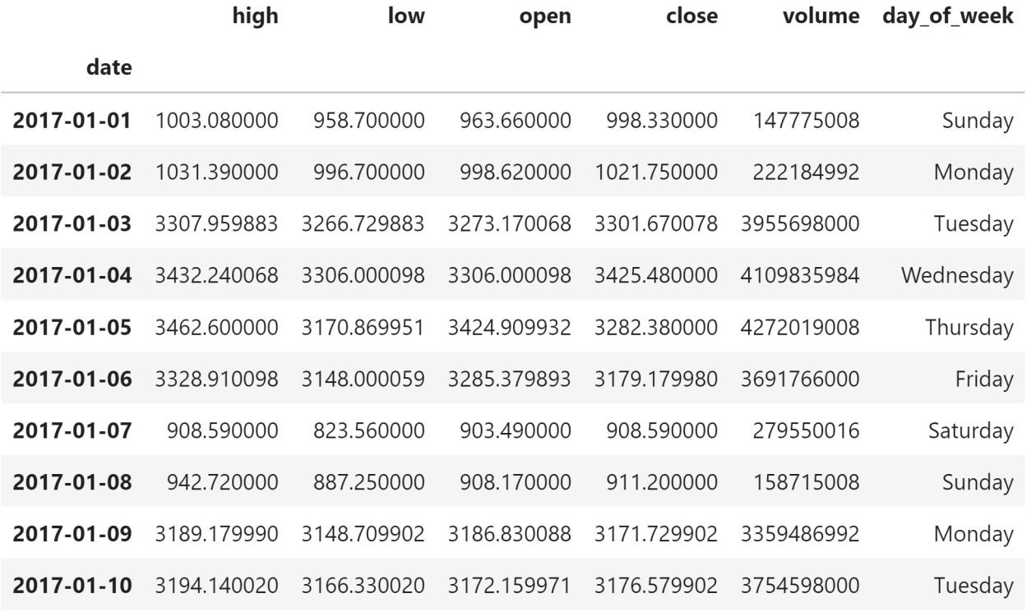
Reordering, reindexing, and sorting data
Now, if we examine our portfolio, we will see that we have values for every day of the week; so far, so good:

Slide 52
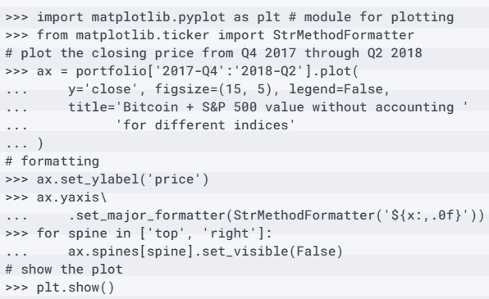
Reordering, reindexing, and sorting data
However, there is a problem with this approach, which is much easier to see with a visualization. Plotting will be covered in depth in Visualizing Data with Pandas and Matplotlib, and Plotting with Seaborn and Customization Techniques, so don't worry about the details for now:

Slide 53
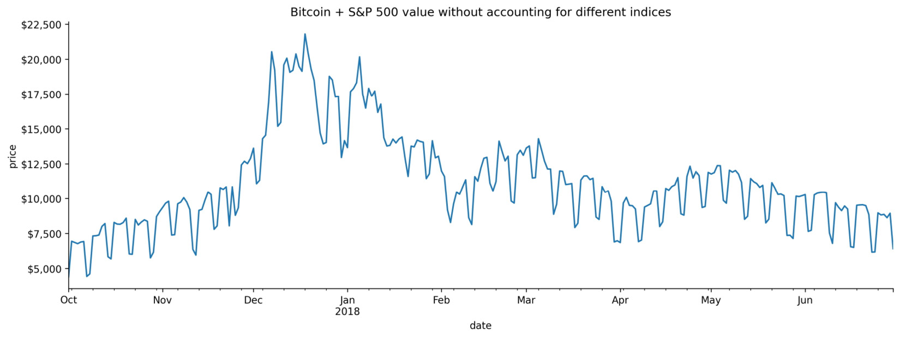
Reordering, reindexing, and sorting data
Notice how there is a cyclical pattern here? It is dropping every day the market is closed because the aggregation only had bitcoin data to sum for those days:
Notes:
Clearly, this is a problem; an asset's value doesn't drop to zero whenever the market is closed. If we want pandas to fill the missing data in for us, we will need to reindex the S&P 500 data with bitcoin's index using the reindex() method, passing one of the following strategies to the method parameter:
'ffill': This method brings values forward. In the previous example, this fills the days the market was closed with the data for the last time the market was open before those days.
'bfill': This method backpropagates the values, which will result in carrying future results to past dates, meaning that this isn't the right option here.
'nearest': This method fills according to the rows closest to the missing ones, which in this case will result in Sundays getting the data for the following Mondays, and Saturdays getting the data from the previous Fridays.

Slide 54
Reordering, reindexing, and sorting data
Forward-filling seems to be the best option, but since we aren't sure, we will see how this works on a few rows of the data first:
>>> sp.reindex(bitcoin.index, method='ffill').head(10)\
... .assign(day_of_week=lambda x: x.index.day_name())

Slide 55
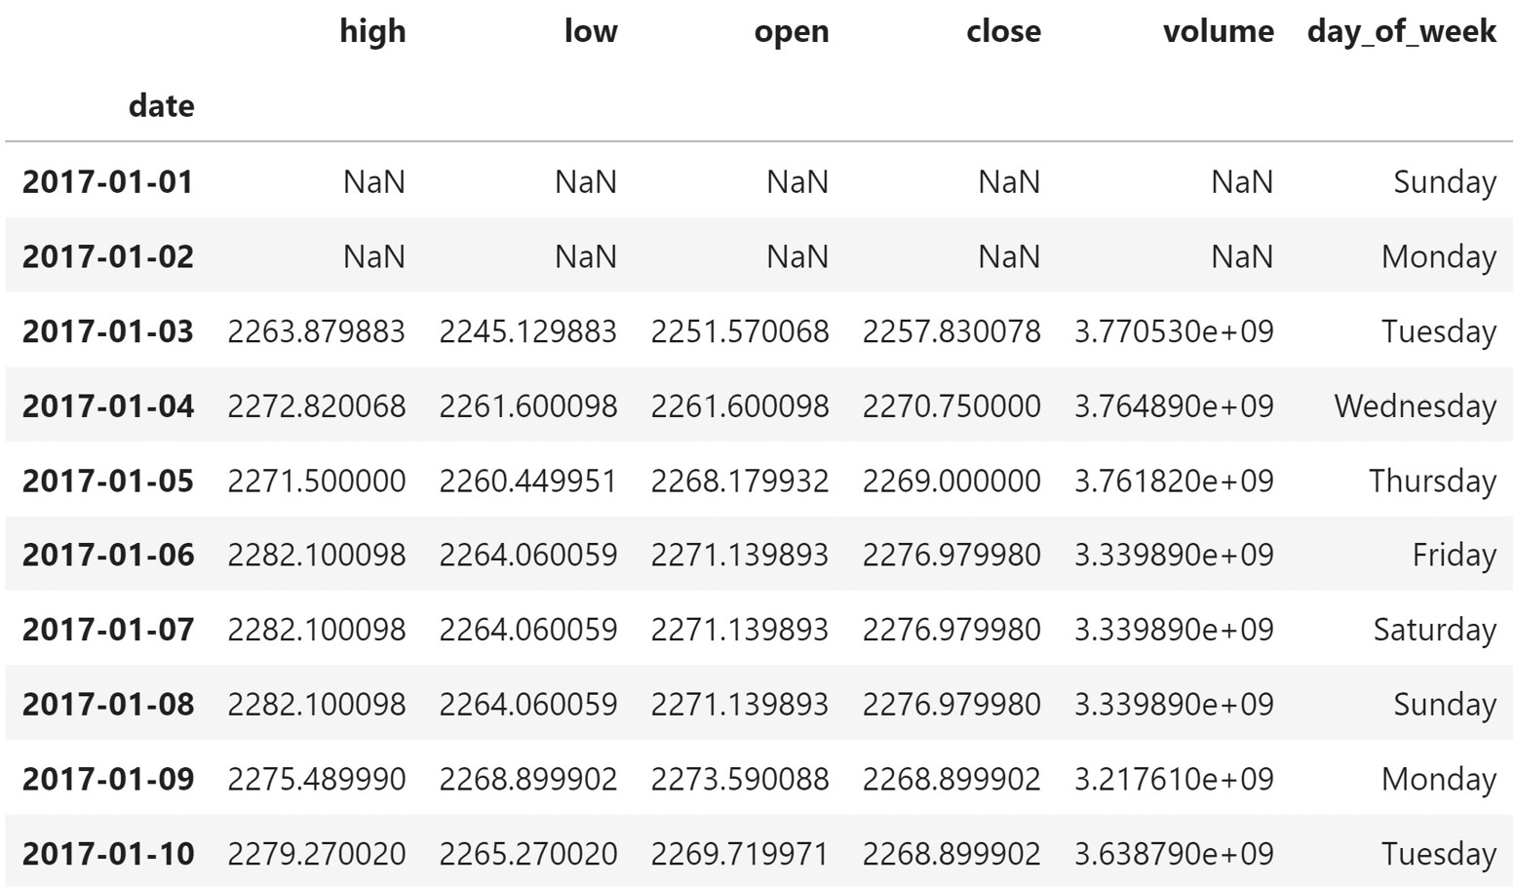
Reordering, reindexing, and sorting data
Notice any issues with this? Well, the volume traded (volume) column makes it seem like the days we used forward-filling for are actually days when the market is open:
Notes:
Tip
The compare() method will show us the values that differ across identically-labeled dataframes (same index and columns); we can use it to isolate the changes in our data when forward-filling here. There is an example in the notebook.
Ideally, we only want to maintain the value of the stock when the stock market is closed—the volume traded should be zero. In order to handle the NaN values in a different manner for each column, we will turn to the assign() method. To fill any NaN values in the volume column with 0, we will use the fillna() method, which we will see more of in the Handling duplicate, missing, or invalid data section, later in this lesson. The fillna() method also allows us to pass in a method instead of a value, so we can forward-fill the close column, which was the only column that made sense from our previous attempt.

Slide 56
Reordering, reindexing, and sorting data
Lastly, we can use the np.where() function for the remaining columns, which allows us to build a vectorized if...else.
It takes the following form:
np.where(boolean condition, value if True, value if False)
Notes:
Vectorized operations are performed on all the elements in the array at once; since each element has the same data type, these calculations can be run rather quickly. As a general rule of thumb, with pandas, we should avoid writing loops in favor of vectorized operations for better performance. NumPy functions are designed to work on arrays, so they are perfect candidates for high-performance pandas code. This will make it easy for us to set any NaN values in the open, high, or low columns to the value in the close column for the same day.

Slide 57
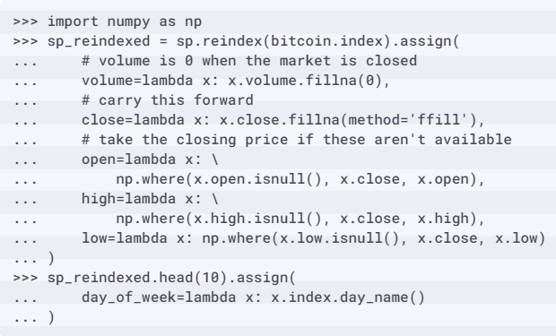
Reordering, reindexing, and sorting data
Since these come after the close column gets worked on, we will have the forward-filled value for close to use for the other columns where necessary:

Slide 58
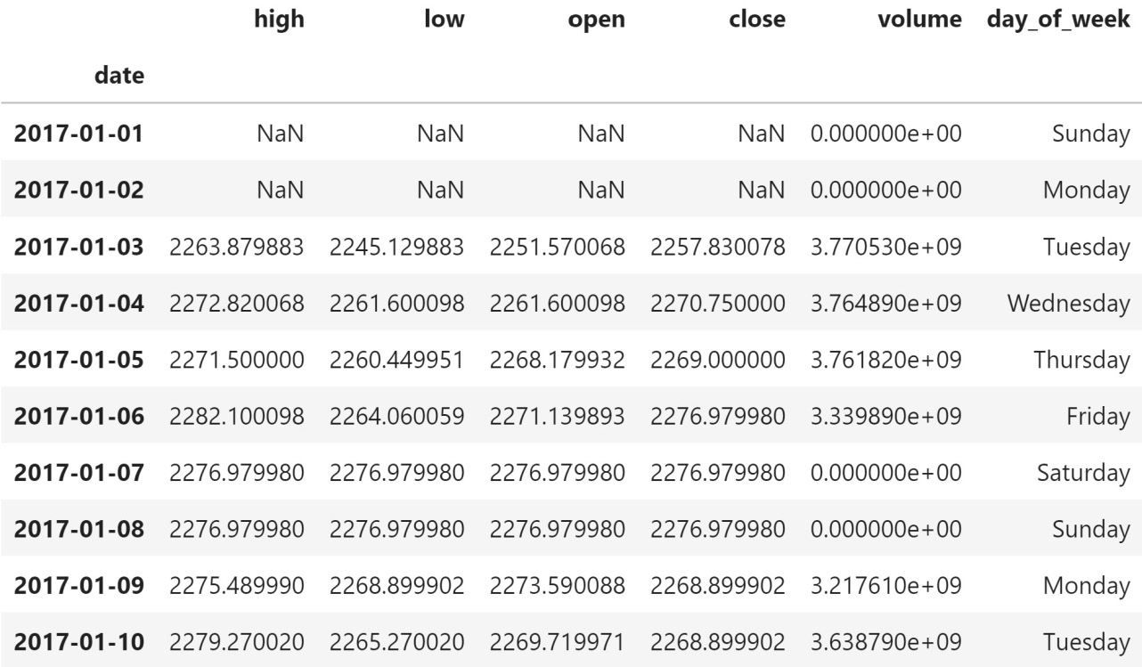
Reordering, reindexing, and sorting data
The OHLC prices are all equal to the closing price on Friday, the 6th:
Notes:
On Saturday, January 7th and Sunday, January 8th, we now have volume traded at zero.
Tip
Here, we use np.where() to both introduce a function we will see throughout this course and to make it easier to understand what is going on, but note that np.where(x.open.isnull(), x.close, x.open) can be replaced with the combine_first() method, which (for this use case) is equivalent to x.open.combine_first(x.close). We will use the combine_first() method in the Handling duplicate, missing, or invalid data section, later this lesson.

Slide 59
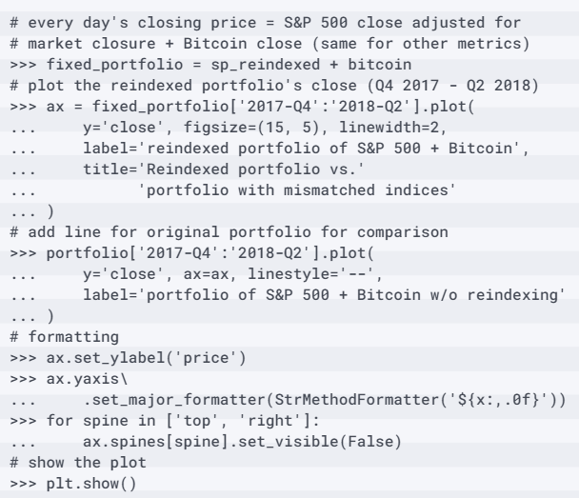
Reordering, reindexing, and sorting data
Now, let's recreate the portfolio with the reindexed S&P 500 data and use a visualization to compare it with the previous attempt (again, don't worry about the plotting code, which will be covered in Visualizing Data with Pandas and Matplotlib, and Plotting with Seaborn and Customization Techniques):

Slide 60
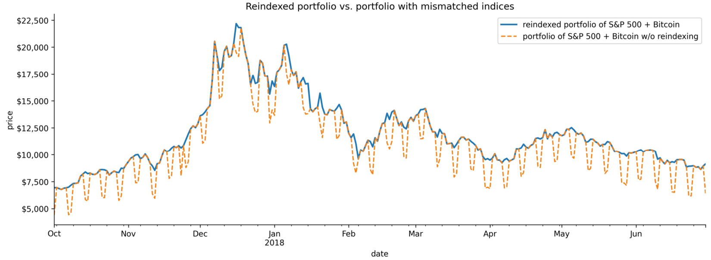
Reordering, reindexing, and sorting data
Keep this strategy in mind for the exercises in Financial Analysis – Bitcoin and the Stock Market:
Notes:
The orange dashed line is our original attempt at studying the portfolio (without reindexing), while the blue solid line is the portfolio we just built with reindexing and different filling strategies per column.
Tip
We can also use the reindex() method to reorder the rows. For example, if our data is stored in x, then x.reindex([32, 20, 11]) will return a new DataFrame object of three rows: 32, 20, and 11 (in that order). This can be done along the columns with axis=1 (the default is axis=0 for rows).
Now, let's turn our attention to reshaping data. Recall that we had to first filter the temperature data by the datatype column and then sort to find the warmest days; reshaping the data will make this easier, and also make it possible for us to aggregate and summarize the data.

Slide 61
Handling duplicate, missing, or invalid data
We will be working in the 5-handling_data_issues.ipynb notebook and using the dirty_data.csv file.
Let's start by importing pandas and reading in the data:
>>> import pandas as pd
>>> df = pd.read_csv('data/dirty_data.csv')
Notes:
So far, we have discussed things we could change with the way the data was represented with zero ramifications. However, we didn't discuss a very important part of data cleaning: how to deal with data that appears to be duplicated, invalid, or missing. This is separated from the rest of the data cleaning discussion because it is an example where we will do some initial data cleaning, then reshape our data, and finally look to handle these potential issues; it is also a rather hefty topic.

Slide 62
Handling duplicate, missing, or invalid data
It contains the following fields:
PRCP: Precipitation in millimeters
SNOW: Snowfall in millimeters
SNWD: Snow depth in millimeters
TMAX: Maximum daily temperature in Celsius
TMIN: Minimum daily temperature in Celsius
TOBS: Temperature at the time of observation in Celsius
WESF: Water equivalent of snow in millimeters
Notes:
This section is divided into two parts. In the first part, we will discuss some tactics to uncover issues within a dataset, and in the second part, we will learn how to mitigate some of the issues present in this dataset.
The dirty_data.csv file contains wide format data from the weather API that has been altered to introduce many common data issues that we will encounter in the wild.

Slide 63
Finding the problematic data
In Working with Pandas DataFrames, we learned the importance of examining our data when we get it; it's not a coincidence that many of the ways to inspect the data will help us find these issues.
Examining the results of calling head() and tail() on the data is always a good first step:
>>> df.head()
Notes:
In practice, head() and tail() aren't as robust as the rest of what we will discuss in this section, but we can still get some useful information by starting here. Our data is in wide format, and at a quick glance, we can see that we have some potential issues. Sometimes, the station field is recorded as ?, while other times, it has a station ID. We have values of negative infinity (-inf) for snow depth (SNWD), along with some very hot temperatures for TMAX.

Slide 64
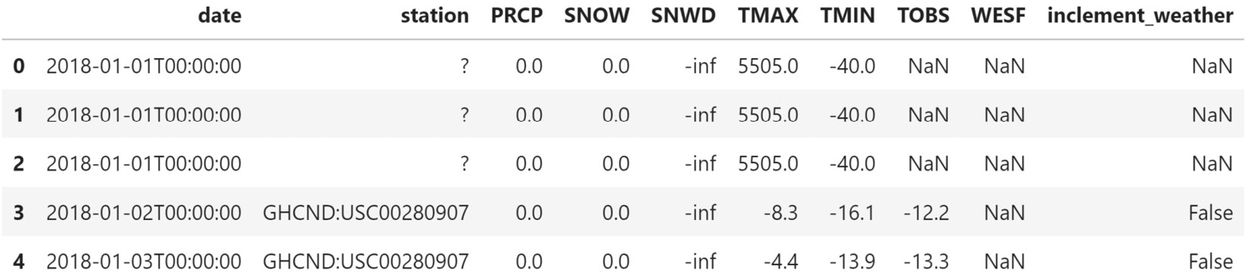
Finding the problematic data
Lastly, we can observe many NaN values in several columns, including the inclement_weather column, which appears to also contain Boolean values:

Slide 65
Finding the problematic data
Using describe(), we can see if we have any missing data and look at the 5-number summary to spot potential issues:
>>> df.describe()
Notes:
The SNWD column appears to be useless, and the TMAX column seems unreliable. For perspective, the temperature of the Sun's photosphere is around 5,505°C, so we certainly wouldn't expect to observe those air temperatures in New York City (or anywhere on Earth, for that matter). This likely means that the TMAX column was set to a nonsensical, large number when it wasn't available. The fact that it is so large is actually what helps identify it using the summary statistics we get from describe().

Slide 66
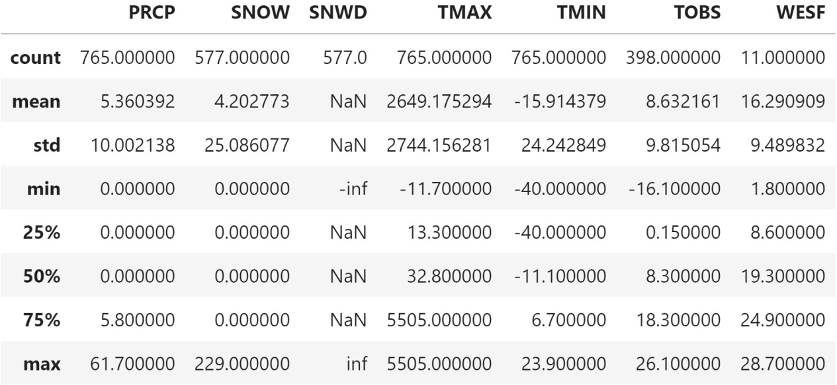
Finding the problematic data
If unknowns were encoded with another value, say 40°C, we couldn't be sure it wasn't actual data:

Slide 67
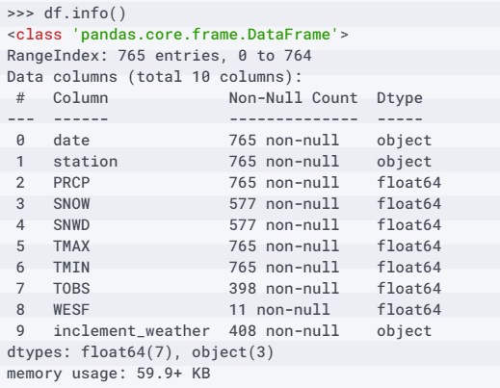
Finding the problematic data
Notes:
We can use the info() method to see if we have any missing values and check that our columns have the expected data types. In doing so, we immediately see two issues: we have 765 rows, but for five of the columns, we have many fewer non-null entries. This output also shows us that the data type of the inclement_weather column is not Boolean, though we may have thought so from the name. Notice that the ? value that we saw for the station column when we used head() doesn't show up here—it's important to inspect our data from many different angles:

Slide 68
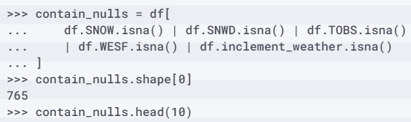
Finding the problematic data
This means that we will need to combine checks for each of the columns with the | (bitwise OR) operator:
Notes:
Now, let's track down those null values. Both Series and DataFrame objects provide two methods to do so: isnull() and isna(). Note that if we use the method on the DataFrame object, the result will tell us which rows have all null values, which isn't what we want in this case. Here, we want to examine the rows that have null values in the SNOW, SNWD, TOBS, WESF, or inclement_weather columns.

Slide 69
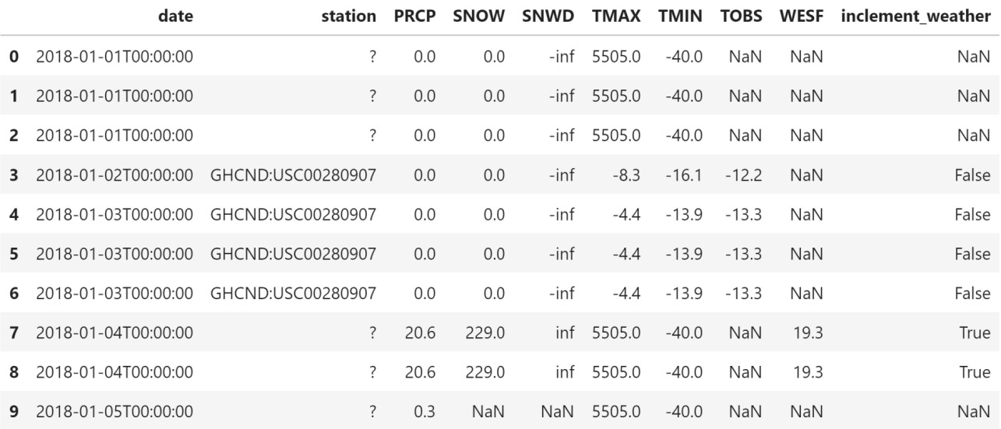
Finding the problematic data
Looking at the top 10 rows, we can see some NaN values in each of these rows:
Notes:
If we look at the shape attribute of our contain_nulls dataframe, we will see that every single row contains some null data.
Tip
By default, the sort_values() method that we discussed earlier in this lesson will put any NaN values last. We can change this behavior (to put them first) by passing in na_position='first', which can also be helpful when looking for patterns in the data when the sort columns have null values.

Slide 70
Finding the problematic data
Note that we can't check whether the value of the column is equal to NaN because NaN is not equal to anything:
>>> import numpy as np
>>> df[df.inclement_weather == 'NaN'].shape[0] # doesn't work
0
>>> df[df.inclement_weather == np.nan].shape[0] # doesn't work
0

Slide 71
Finding the problematic data
We must use the aforementioned options (isna()/isnull()):
>>> df[df.inclement_weather.isna()].shape[0] # works
357

Slide 72
Finding the problematic data
Note that inf and -inf are actually np.inf and -np.inf.
Therefore, we can find the number of rows with inf or -inf values by doing the following:
>>> df[df.SNWD.isin([-np.inf, np.inf])].shape[0]
577

Slide 73
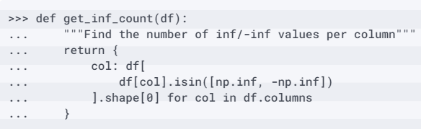
Finding the problematic data
This only tells us about a single column, though, so we could write a function that will use a dictionary comprehension to return the number of infinite values per column in our dataframe:

Slide 74
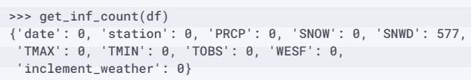
Finding the problematic data
Using our function, we find that the SNWD column is the only column with infinite values, but the majority of the values in the column are infinite:
Notes:
Before we can decide on how to handle the infinite values of snow depth, we should look at the summary statistics for snowfall (SNOW), which forms a big part of determining the snow depth (SNWD). To do so, we can make a dataframe with two series, where one contains the summary statistics for the snowfall column when the snow depth is np.inf, and the other for when it is -np.inf.

Slide 75
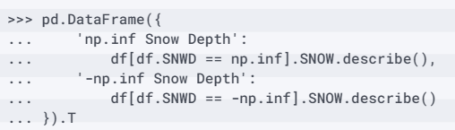
Finding the problematic data
In addition, we will use the T attribute to transpose the data for easier viewing:
Notes:
The snow depth was recorded as negative infinity when there was no snowfall; however, we can't be sure this isn't just a coincidence going forward. If we are just going to be working with this fixed date range, we can treat that as having a depth of 0 or NaN because it didn't snow. Unfortunately, we can't really make any assumptions with the positive infinity entries.

Slide 76
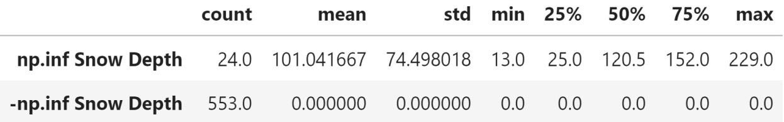
Finding the problematic data
They most certainly aren't that, but we can't decide what they should be, so it's probably best to leave them alone or not look at this column:

Slide 77
Finding the problematic data
We are working with a year of data, but somehow, we have 765 rows, so we should check why.
The only columns we have yet to inspect are the date and station columns.
We can use the describe() method to see the summary statistics for them:
>>> df.describe(include='object')
Notes:
In 765 rows of data, the date column only has 324 unique values (meaning that some dates are missing), with some dates being present as many as eight times (freq). There are only two unique values for the station column, with the most frequent being GHCND:USC00280907. Since we saw some station IDs with the value of ? when we used head() earlier, we know that is the other value; however, we can use unique() to see all the unique values if we hadn't.

Slide 78
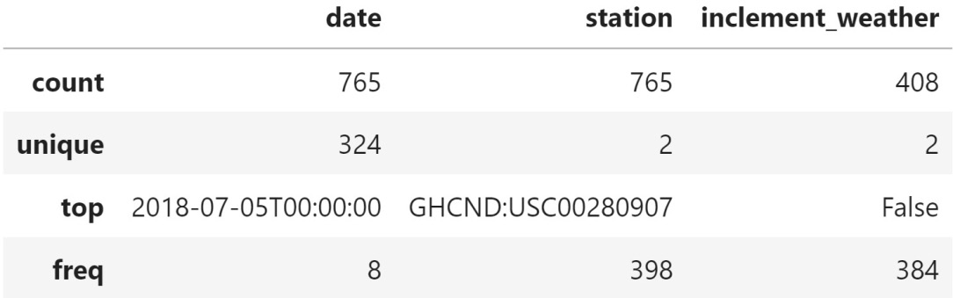
Finding the problematic data
We also know that ? occurs 367 times (765 - 398), without the need to use value_counts():
Notes:
In practice, we may not know why the station is sometimes recorded as ?—it could be intentional to show that they don't have the station, an error in the recording software, or an accidental omission that got encoded as ?. How we deal with this would be a judgment call, as we will discuss in the next section.
Upon seeing that we had 765 rows of data and two distinct values for the station ID, we might have assumed that each day had two entries—one per station. However, this would only account for 730 rows, and we also now know that we are missing some dates. Let's see whether we can find any duplicate data that could account for this.

Slide 79
Finding the problematic data
We can use the result of the duplicated() method as a Boolean mask to find the duplicate rows:
>>> df[df.duplicated()].shape[0]
284
Notes:
Depending on what we are trying to achieve, we may handle duplicates differently. The rows that are returned can be modified with the keep argument. By default, it is 'first', and, for each row that is present more than once, we will get only the additional rows (besides the first).

Slide 80
Finding the problematic data
However, if we pass in keep=False, we will get all the rows that are present more than once, not just each additional appearance they make:
>>> df[df.duplicated(keep=False)].shape[0]
482
Notes:
There is also a subset argument (first positional argument), which allows us to focus just on the duplicates of certain columns. Using this, we can see that when the date and station columns are duplicated, so is the rest of the data because we get the same result as before.

Slide 81
Finding the problematic data
However, we don't know if this is actually a problem:
>>> df[df.duplicated(['date', 'station'])].shape[0]
284
Now, let's examine a few of the duplicated rows:
>>> df[df.duplicated()].head()

Slide 82
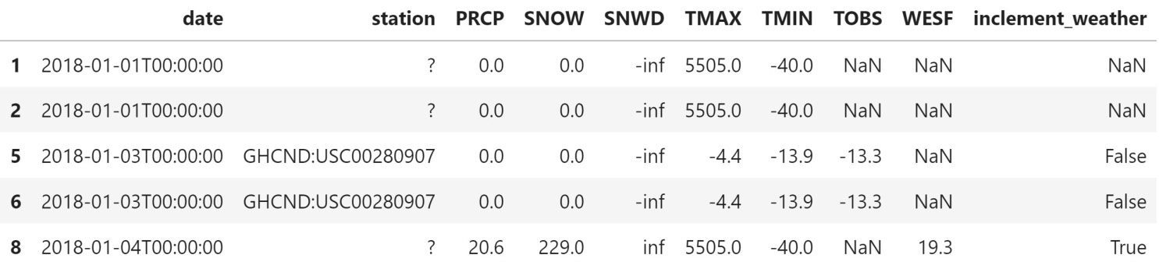
Finding the problematic data
Just looking at the first five rows shows us that some rows are repeated at least three times.
Remember that the default behavior of duplicated() is to not show the first occurrence, which means that rows 1 and 2 have another matching value in the data (same for rows 5 and 6):
Notes:
Now that we know how to find problems in our data, let's learn about some ways we can try to address them. Note that there is no panacea here, and it will often come down to knowing the data we are working with and making judgment calls.

Slide 83
Mitigating the issues
If we then decide to remove duplicate rows using the date column and keep the data for the station that wasn't ?, in the case of duplicates, we will lose all data we have for the WESF column because the ? station is the only one reporting WESF measurements:
>>> df[df.WESF.notna()].station.unique()
array(['?'], dtype=object)
Notes:
We are in an unsatisfactory state with our data, and while we can work to make it better, the best plan of action isn't always evident. Perhaps the easiest thing we can do when faced with this class of data issues is to remove the duplicate rows. However, it is crucial that we evaluate the ramifications such a decision may have on our analysis. Even in cases where it appears that the data we are working with was collected from a larger dataset that had additional columns, thus making all our data distinct, we can't be sure that removing these columns is the reason the remaining data was duplicated—we would need to consult the source of the data and any available documentation.
Since we know that both stations will be for New York City, we may decide to drop the station column—they may have just been collecting different data.

Slide 84
Mitigating the issues
One satisfactory solution in this case may be to carry out the following actions:
Perform type conversion on the date column:
>>> df.date = pd.to_datetime(df.date)
Save the WESF column as a series:
>>> station_qm_wesf = df[df.station == '?']\
... .drop_duplicates('date').set_index('date').WESF

Slide 85
Mitigating the issues
Sort the dataframe by the station column in descending order to put the station with no ID (?) last:
>>> df.sort_values(
... 'station', ascending=False, inplace=True
... )

Slide 86
Mitigating the issues
Remove rows that are duplicated based on the date, keeping the first occurrences, which will be ones where the station column has an ID (if that station has measurements).
>>> df_deduped = df.drop_duplicates('date')
Notes:
Note that drop_duplicates() can be done in-place, but if what we are trying to do is complicated, it's best not to start out with the in-place operation:

Slide 87
Mitigating the issues
Drop the station column and set the index to the date column (so that it matches the WESF data):
>>> df_deduped = df_deduped.drop(columns='station')\
... .set_index('date').sort_index()

Slide 88
Mitigating the issues
Since both df_deduped and station_qm_wesf are using the date as the index, the values are properly matched to the appropriate date:
>>> df_deduped = df_deduped.assign(WESF=
... lambda x: x.WESF.combine_first(station_qm_wesf)
... )
Notes:
Update the WESF column using the combine_first() method to coalesce (just as in SQL for those coming from a SQL background) the values to the first non-null entry; this means that if we had data from both stations, we would first take the value provided by the station with an ID, and if (and only if) that station was null would we take the value from the station without an ID (?).

Slide 89
Mitigating the issues
Let's take a look at the result using the aforementioned implementation:
>>> df_deduped.shape
(324, 8)
>>> df_deduped.head()
Notes:
This may sound a little complicated, but that's largely because we haven't learned about aggregation yet. In Aggregating Pandas DataFrames, we will look at another way to go about this.

Slide 90
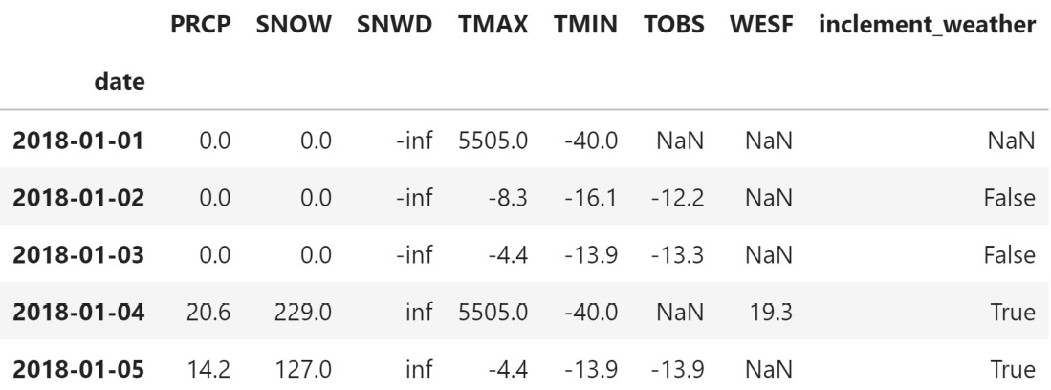
Mitigating the issues
We are now left with 324 rows—one for each unique date in our data.
We were able to save the WESF column by putting it alongside the data from the other station:
Notes:
Tip
We could have also specified to keep the last entry instead of the first or drop all duplicates with the keep argument, just like when we checked for duplicates with duplicated(). Keep this in mind as the duplicated() method can be useful in giving the results of a dry run on a deduplication task.
Now, let's deal with the null data. We can choose to drop it, replace it with some arbitrary value, or impute it using surrounding data. Each of these options has its ramifications. If we drop the data, we are going about our analysis with only part of the data; if we end up dropping half the rows, this is going to have a big impact. When changing the values of the data, we may be affecting the outcome of our analysis.

Slide 91
Mitigating the issues
To drop all the rows with any null data (this doesn't have to be true for all the columns of the row, so be careful), we use the dropna() method; in our case, this leaves us with just 4 rows:
>>> df_deduped.dropna().shape
(4, 8)

Slide 92
Mitigating the issues
We can change the default behavior to only drop a row if all the columns are null with the how argument, except this doesn't get rid of anything:
>>> df_deduped.dropna(how='all').shape # default is 'any'
(324, 8)

Slide 93
Mitigating the issues
This can be achieved with the subset argument:
>>> df_deduped.dropna(
... how='all', subset=['inclement_weather', 'SNOW', 'SNWD']
... ).shape
(293, 8)
Notes:
Thankfully, we can also use a subset of columns to determine what to drop. Say we wanted to look at snow data; we would most likely want to make sure that our data had values for SNOW, SNWD, and inclement_weather.

Slide 94
Mitigating the issues
For example, if we say that at least 75% of the rows must be null to drop the column, we will drop the WESF column:
>>> df_deduped.dropna(
... axis='columns',
... thresh=df_deduped.shape[0] * .75 # 75% of rows
... ).columns
Index(['PRCP', 'SNOW', 'SNWD', 'TMAX', 'TMIN', 'TOBS',
'inclement_weather'],
dtype='object')
Notes:
Note that this operation can also be performed along the columns, and that we can provide a threshold for the number of null values that must be observed to drop the data with the thresh argument.
Since we have a lot of null values, we will likely be more interested in keeping these values, and perhaps finding a better way to represent them. If we replace the null data, we must exercise caution when deciding what to fill in instead; filling in all the values we don't have with some other value may yield strange results later on, so we must think about how we will use this data first.
To fill in null values with other data, we use the fillna() method, which gives us the option of specifying a value or a strategy for how to perform the filling. We will discuss filling with a single value first. The WESF column contains mostly null values, but since it is a measurement in milliliters that takes on the value of NaN when there is no water equivalent of snowfall, we can fill in the nulls with zeros.

Slide 95
Mitigating the issues
Note that this can be done in-place (again, as a general rule of thumb, we should use caution with in-place operations):
>>> df_deduped.loc[:,'WESF'].fillna(0, inplace=True)
>>> df_deduped.head()

Slide 96
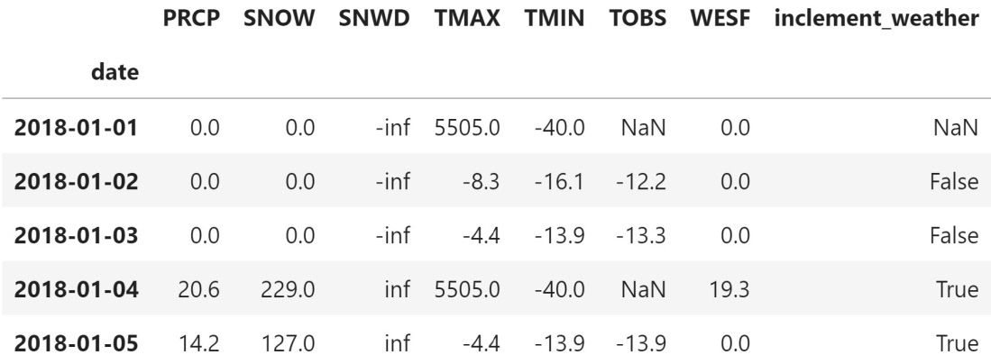
Mitigating the issues
The WESF column no longer contains NaN values:
Notes:
At this point, we have done everything we can without distorting the data. We know that we are missing dates, but if we reindex, we don't know how to fill in the resulting NaN values. With the weather data, we can't assume that because it snowed one day that it will snow the next, or that the temperature will be the same. For this reason, note that the following examples are just for illustrative purposes only—just because we can do something doesn't mean we should. The right solution will most likely depend on the domain and the problem we are looking to solve.
That being said, let's try to address some of the remaining issues with the temperature data. We know that when TMAX is the temperature of the Sun, it must be because there was no measured value, so let's replace it with NaN.

Slide 97
Mitigating the issues
We will also do so for TMIN, which currently uses -40°C for its placeholder, despite the coldest temperature ever recorded in NYC being -15°F (-26.1°C) on February 9, 1934 (https://www.weather.gov/media/okx/Climate/CentralPark/extremes.pdf):
>>> df_deduped = df_deduped.assign(
... TMAX=lambda x: x.TMAX.replace(5505, np.nan),
... TMIN=lambda x: x.TMIN.replace(-40, np.nan)
... )
Notes:
We will also make an assumption that the temperature won't change drastically from day to day. Note that this is actually a big assumption, but it will allow us to understand how the fillna() method works when we provide a strategy through the method parameter: 'ffill' to forward-fill or 'bfill' to back-fill.

Slide 98
Mitigating the issues
Notice we don't have the 'nearest' option, like we did when we were reindexing, which would have been the best option; so, to illustrate how this works, let's use forward-filling:
>>> df_deduped.assign(
... TMAX=lambda x: x.TMAX.fillna(method='ffill'),
... TMIN=lambda x: x.TMIN.fillna(method='ffill')
... ).head()

Slide 99
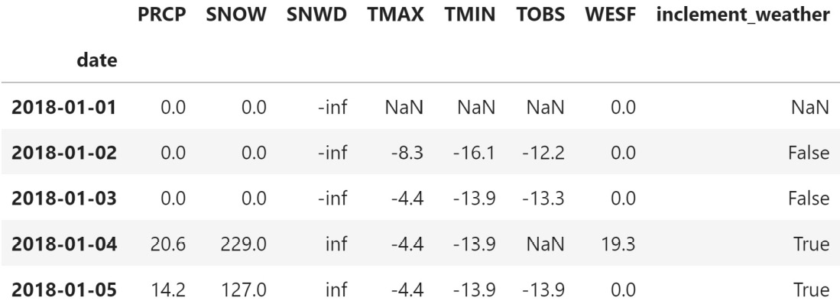
Mitigating the issues
Take a look at the TMAX and TMIN columns on January 1st and 4th.
Both are NaN on the 1st because we don't have data before then to bring forward, but the 4th now has the same values as the 3rd:

Slide 100
Mitigating the issues
If we want to handle the nulls and infinite values in the SNWD column, we can use the np.nan_to_num() function; it turns NaN into 0 and inf/-inf into very large positive/negative finite numbers, making it possible for machine learning models (discussed in Getting Started with Machine Learning in Python) to learn from this data:
>>> df_deduped.assign(
... SNWD=lambda x: np.nan_to_num(x.SNWD)
... ).head()
Notes:
This doesn't make much sense for our use case though. For instances of -np.inf, we may choose to set SNWD to 0 since we saw there was no snowfall on those days.

Slide 101
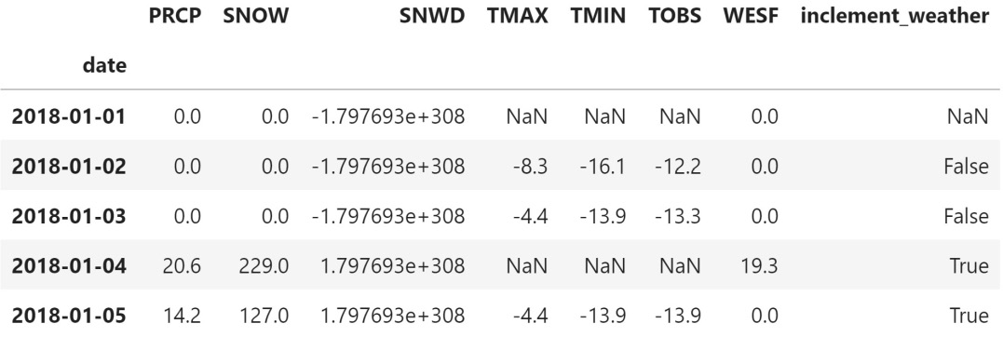
Mitigating the issues
However, we don't know what to do with np.inf, and the large positive numbers, arguably, make this more confusing to interpret:

Slide 102
Mitigating the issues
To show how the upper bound works, we will use the snowfall (SNOW) as an estimate:
>>> df_deduped.assign(
... SNWD=lambda x: x.SNWD.clip(0, x.SNOW)
... ).head()
Notes:
Depending on the data we are working with, we may choose to use the clip() method as an alternative to the np.nan_to_num() function. The clip() method makes it possible to cap values at a specific minimum and/or maximum threshold. Since the snow depth can't be negative, let's use clip() to enforce a lower bound of zero.

Slide 103
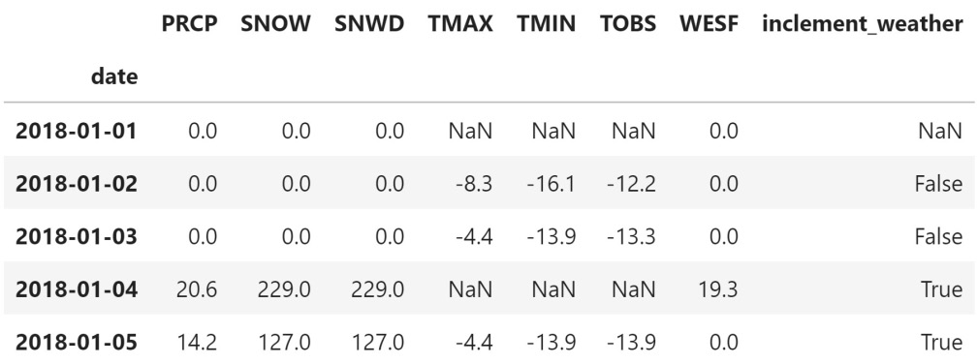
Mitigating the issues
The values of SNWD for January 1st through 3rd are now 0 instead of -inf, while the values of SNWD for January 4th and 5th went from inf to that day's value for SNOW:
Notes:
Our last strategy is imputation. When we replace a missing value with a new value derived from the data, using summary statistics or data from other observations, it is called imputation. For example, we can impute with the mean to replace temperature values. Unfortunately, if we are only missing values for the end of the month of October, and we replace them with the mean of the values from the rest of the month, this is likely to be skewed toward the extreme values, which are the warmer temperatures at the beginning of October, in this case. Like everything else that was discussed in this section, we must exercise caution and think about any potential consequences or side effects of our actions.

Slide 104
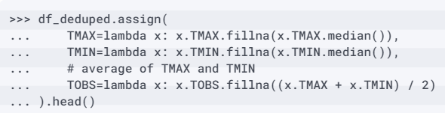
Mitigating the issues
We can combine imputation with the fillna() method.
As an example, let's fill in the NaN values for TMAX and TMIN with their medians and TOBS with the average of TMIN and TMAX (after imputing them):
Notes:
Notice from the changes to the data for January 1st and 4th that the median maximum and minimum temperatures were 14.4°C and 5.6°C, respectively.

Slide 105
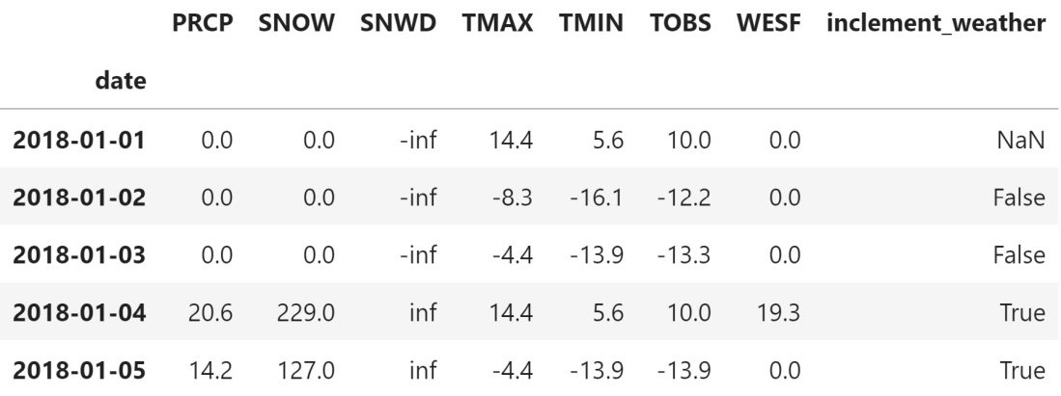
Mitigating the issues
This means that when we impute TOBS and also don't have TMAX and TMIN in the data, we get 10°C:
Notes:
If we want to run the same calculation on all the columns, we should use the apply() method instead of assign(), since it saves us the redundancy of having to write the same calculation for each of the columns. For example, let's fill in all the missing values with the rolling 7-day median of their values, setting the number of periods required for the calculation to zero to ensure that we don't introduce extra null values.

Slide 106

Mitigating the issues
We will cover rolling calculations and apply() in Aggregating Pandas DataFrames, so this is just a preview:
Notes:
It's kind of hard to tell where our imputed values are here—temperatures can fluctuate quite a bit day to day. We know that January 4th had missing data from our previous attempt; our imputed temperatures are colder that day than those around it with this strategy.

Slide 107

Mitigating the issues
In reality, it was slightly warmer that day (around -3°C):
Notes:
Important note
It's important to exercise caution when imputing. If we pick the wrong strategy for the data, we can make a real mess of things.
Another way of imputing missing data is to have pandas calculate what the values should be with the interpolate() method. By default, it will perform linear interpolation, making the assumption that all the rows are evenly spaced. Our data is daily data, although some days are missing, so it is just a matter of reindexing first.

Slide 108
Mitigating the issues
Let's combine this with the apply() method to interpolate all of our columns at once:
>>> df_deduped.reindex(
... pd.date_range('2018-01-01', '2018-12-31', freq='D')
... ).apply(lambda x: x.interpolate()).head(10)

Slide 109

Mitigating the issues
Check out January 9th, which we didn't have previously—the values for TMAX, TMIN, and TOBS are the average of the values for the day prior (January 8th) and the day after (January 10th):
Notes:
Different strategies for interpolation can be specified via the method argument; be sure to check out the interpolate() method documentation to view the available options.

Slide 110
Summary
In this lesson, we learned more about what data wrangling is (aside from a data science buzzword) and got some firsthand experience with cleaning and reshaping our data.
Utilizing the requests library, we once again practiced working with APIs to extract data of interest; then, we used pandas to begin our introduction to data wrangling, which we will continue in the next lesson.
Finally, we learned how to deal with duplicate, missing, and invalid data points in various ways and discussed the ramifications of those decisions.
Notes:
Congratulations on making it through this lesson! Data wrangling may not be the most exciting part of the analytics workflow, but we will spend a lot of time on it, so it's best to be well versed in what pandas has to offer.
Building on these concepts, in the next lesson, we will learn how to aggregate dataframes and work with time series data. Be sure to complete the end-of-lesson exercises before moving on.

Slide 111
"Complete Exercises"

Slide 112
"Complete Lab 3"

